Slide 1
Paper presentation
Gradient Obfuscation Gives a False Sense of Security in
Federated Learning
- Manogna Chennuru

Slide 2
What is Federated Learning ?
Traditionally, both the model and the data reside on the same device, a practice known as centralized machine learning.
For tech giants, centralized machine learning involves uploading users' private conversations to the cloud for training their machine learning models.
Federated learning shifts the paradigm: rather than sending data to the cloud, models are sent to user devices for training.

Slide 3
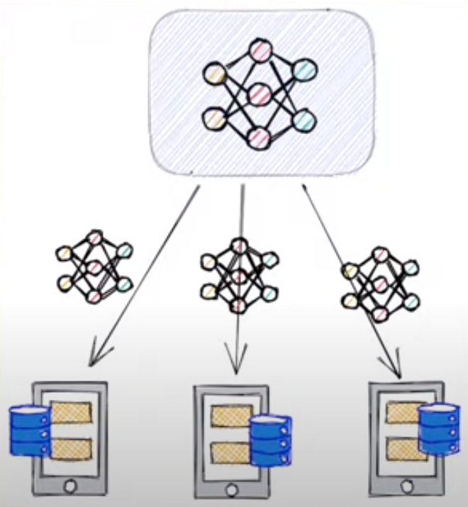
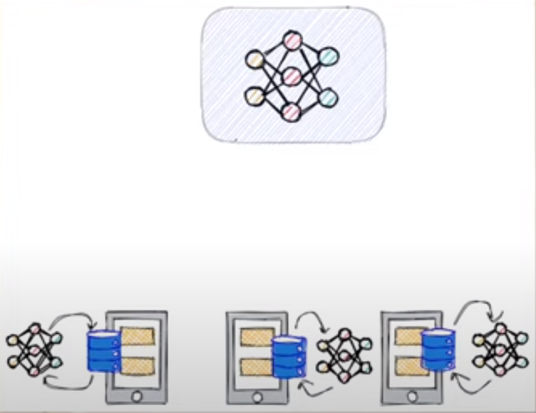
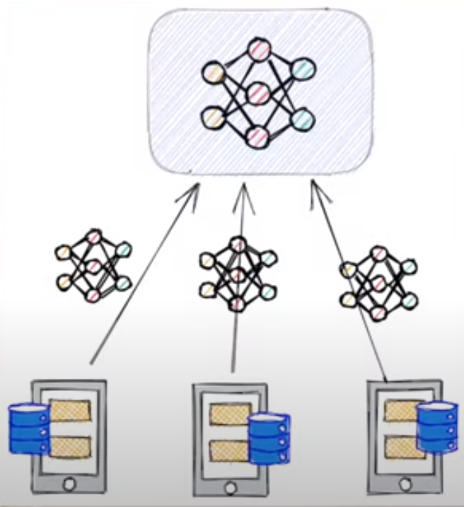
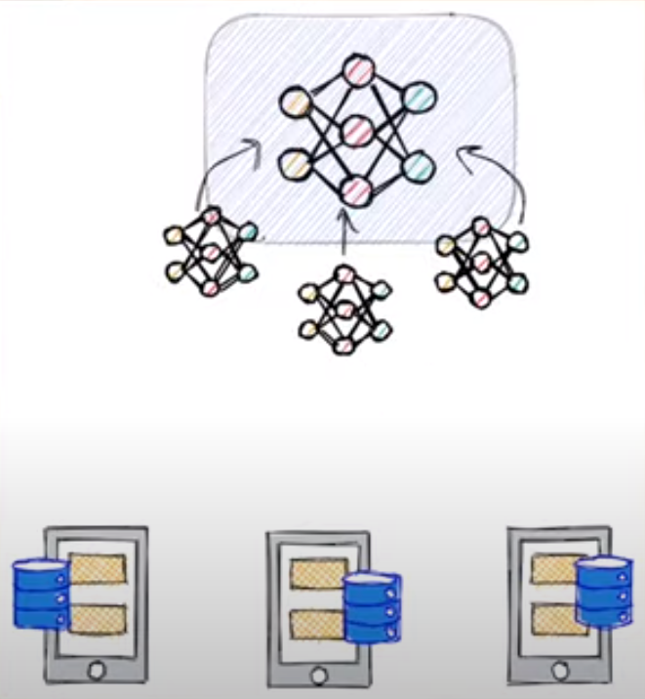
Federated Learning in Five Steps
Step 1: Initialize global model
Send model to a number of connected organizations/devices (client nodes)
Step 2: Train model locally on the data of each organization/device (client node)
Step 4: Aggregate model updates into a new global model
Repeat steps 1 to 4 until the model converges
Step 3: Return model updates back to the server

Slide 4
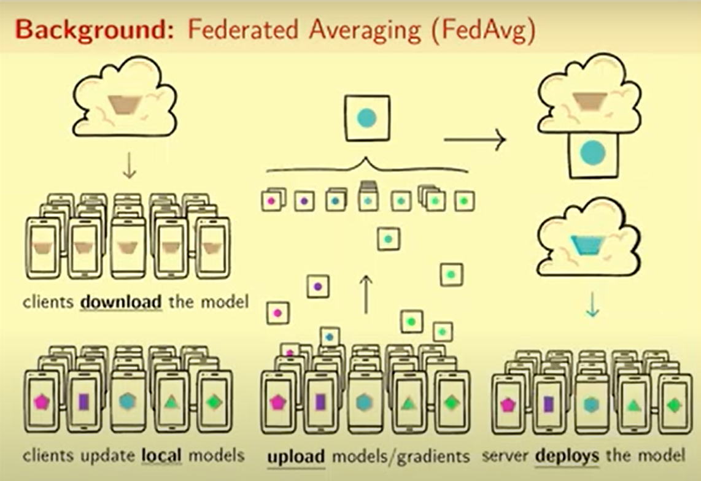
Fed Avg

Slide 5
Understanding the title: Gradient Obfuscation Gives a False Sense of Security in Federated Learning
Gradient
“Gradient” usually refers to the rate of change of a quantity with respect to another relevant quantity
Obfuscation
“Obfuscation” is the deliberate act of making something unclear or confusing.
False Sense of Security
Refers to an illusion of heightened privacy protection.
In the context of FL: Gradients show how much and in what direction the model's parameters need to change to improve performance.
In the context of FL: gradient obfuscation involves modifying gradients shared between clients and the server to prevent adversaries from reconstructing sensitive client data.
Despite the application of gradient obfuscation methods, such as noise injection or compression, the privacy of client data may remain compromised due to potential vulnerabilities in these techniques.

Slide 6
Can Privacy be Leaked in Federated Learning?
Federated learning facilitates collaboration without sharing raw data.
However, an honest-but-curious server may pose privacy risks.
Adversaries can potentially reconstruct sensitive data from shared gradients.
The paper introduces a framework to reconstruct image data from obfuscated gradients in federated learning.

Slide 7
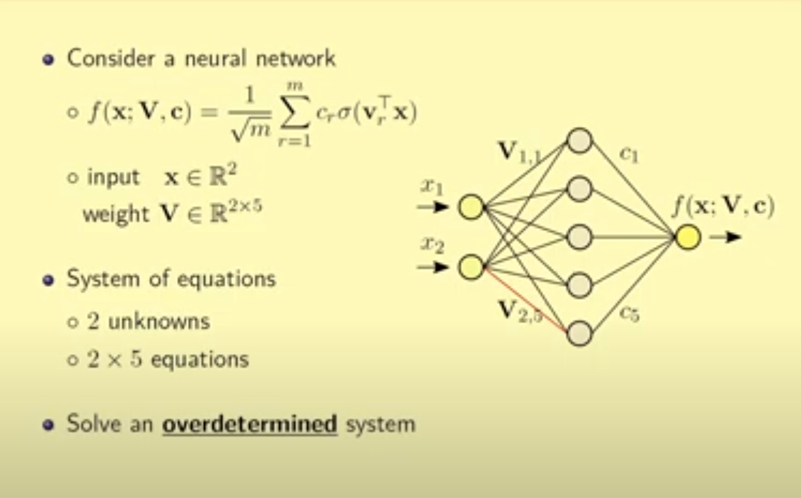
Raw data can be reconstructed!
The goal of the attacker is to reconstruct the input data (yellow nodes) while having access to the gradients corresponding to the connections in the first layer of the neural network.
The situation is framed as a system of equations where the attacker knows ten equations (representing the gradients) but only has two unknowns (input yellow nodes), resulting in an overdetermined system.
Despite being overdetermined, the system can still be resolved, allowing the attacker to reconstruct the input data with relatively low error.

Slide 8
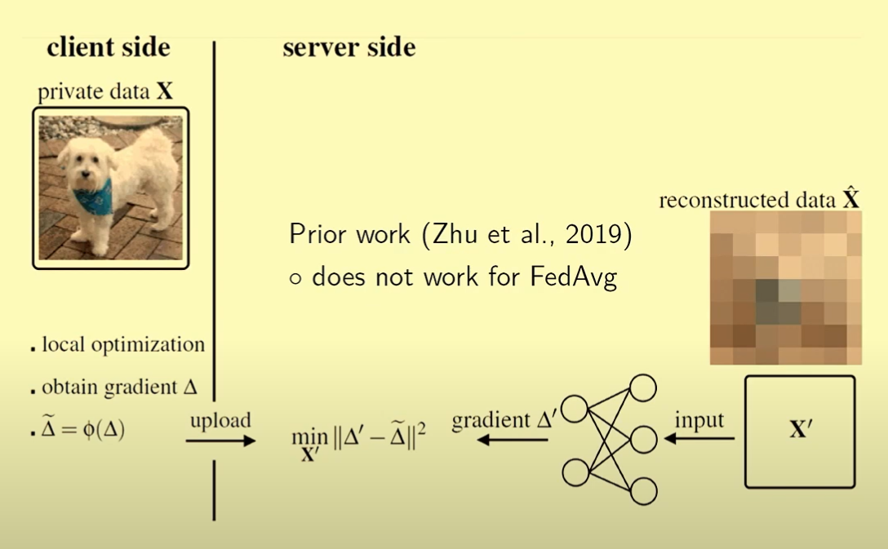
ROG : Reconstruct from Obfuscated Gradients
Prior Work:
Prior work proposed schemes to reconstruct images based on the received gradients, but these schemes were ineffective against certain defense mechanisms like federated averaging (FedAvg).

Slide 9
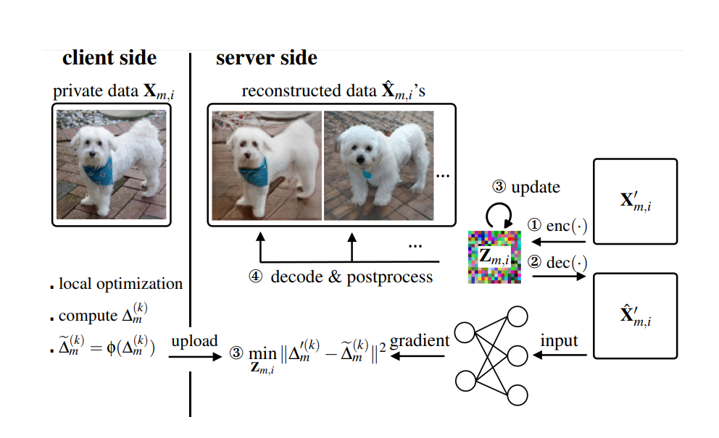
ROG : Reconstruct from Obfuscated Gradients
Proposed Framework:
The proposed framework introduces a pair of encoder and decoder.
Images are first projected into a low-dimensional space by the encoder and then mapped back to the image space by the decoder.
This framework offers two main benefits:
Reducing the number of unknowns, which accelerates the optimization problem by constraining the search space.
Providing flexibility in design by allowing the use of various encoder and decoder models, such as GANs or autoencoders.

Slide 10
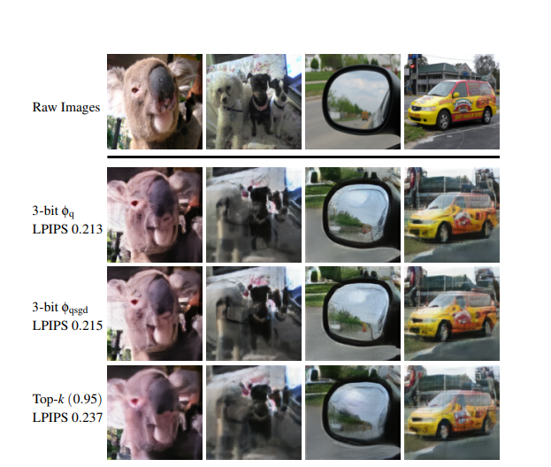
Case Study : Does Gradient Compression imply privacy
Reconstructed images when gradient compression is applied in FedAvg. The compression methods include: 3-bit uniform quantizer φq, 3-bit QSGD quantizer φqsgd, and Top-k method φtopk with the sparsity set to 0.95. The reconstructed images are visually similar to the raw private images
LPIPS (Learned Perceptual Image Patch Similarity) is a metric used to measure the perceptual similarity between original and reconstructed images after gradient compression in federated learning.
Lower LPIPS scores indicate higher perceptual similarity, suggesting effective retention of visual information.

Slide 11
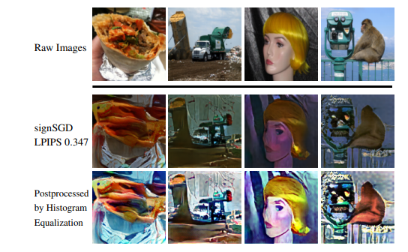
Case Study : Binary Quantization
Reconstructed images from signSGD. Despite the loss of magnitude information caused by 1-bit quantization, ROG can reconstruct results visually similar to the raw images.
One bit Quantization: SignSGD
Each entry of gradient is represented by its sign
Despite compression, reconstructed images reveal visual information from original images.
Prior studies success with compression may lead to false sense of security.

Slide 12
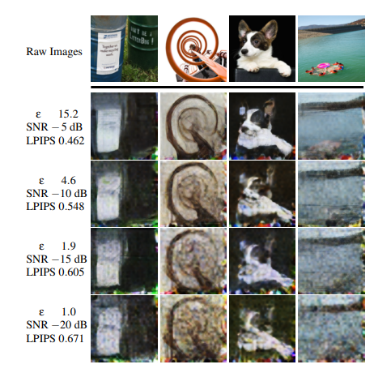
Defense : Differential Privacy
ROG attack results when FedCDP is used as the defense scheme. The reconstructed images gradually degrade as the defense strength increases.
A higher SNR (Signal-to-Noise Ratio) signifies a stronger signal compared to the noise, resulting in clearer and easily interpretable data.
When the SNR is −20 dB, some structural information can still be revealed whereas the accuracy has dropped severely compared to FedAvg
Increased Privacy – Decreased Utility.

Slide 13
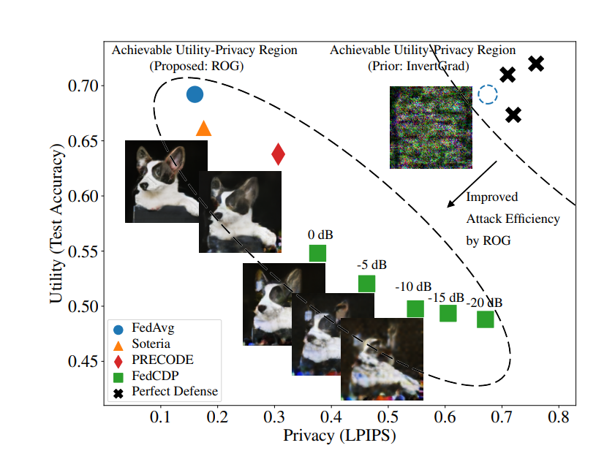
Improved Attack Efficiency
Trade-off between model accuracy and privacy under the ROG attack
A larger LPIPS value indicates better privacy protection against the attack.
Cross points Represent desired (yet unrealistic) defense schemes for high model accuracy and privacy protection.
Dotted Circle Depicts FedAvg's operating point under the InvertGrad attack, falsely categorized with desired defenses, potentially leading to a false sense of security
However, the three defense schemes effectively countered the InvertGrad attack, indicating their efficacy as desired defenses.
The proposed ROG attack shifts the achievable utility–privacy region to the bottom left.

Slide 14
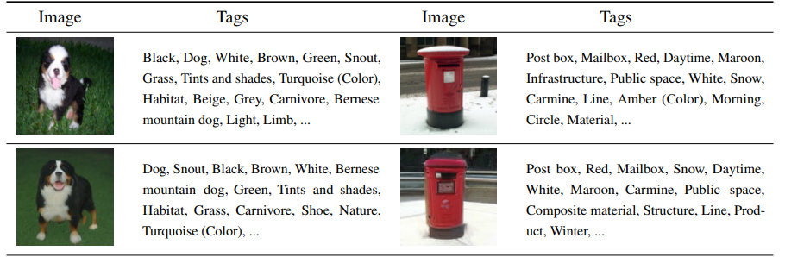
Semantic Level Attack Variant: ROGS
ROGS employs pretrained generative models like BigGAN for higher-level image reconstruction, preserving knowledge and semantics.
It aims to reconstruct images that retain the same knowledge and semantics as the original, broadening the scope of privacy compromise beyond specific attributes like gender or age.

Slide 15
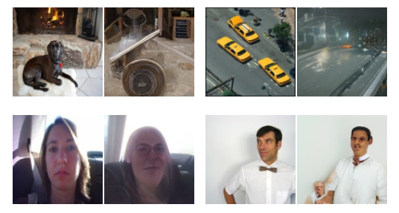
Limitations
Challenges in Complex Scenarios: ROGS may struggle with reconstructing images containing intricate compositions or multiple dominant objects, hindering successful convergence.
Identification of Human Faces: Reconstructions involving human faces may fail to accurately reveal identities, impacting applications such as facial data analysis.

Slide 16
Conclusion
The authors studied privacy leakage under various obfuscation mechanisms in federated learning.
Proposed an attack framework, which shows that
Compressed gradient: does not protect privacy inherently.
Noisy gradient (DP): bad trade off between utility & privacy.

Slide 17
Future Scope
Hybrid Defense Strategies: Investigate trade-offs between utility and privacy by combining multiple defense mechanisms for enhanced protection.
Broadening Privacy Research: Extend studies beyond image classification to uncover privacy leakage in diverse applications, offering valuable insights to the research community.

Slide 18
References
https://www.usenix.org/system/files/usenixsecurity23-yue.pdf
https://youtu.be/tuz7S77iG4w?feature=shared
https://flower.ai/docs/framework/tutorial-series-what-is-federated-learning.html
https://youtu.be/X8YYWunttOY?si=4-sWzeuPOgwkKwOY

Slide 19
Thankyou !

